Slide 1
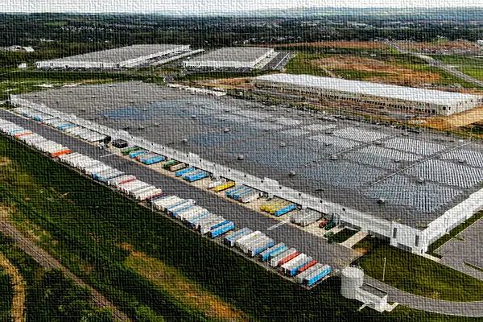
Trailer Management System
Gregory Stone

Slide 2
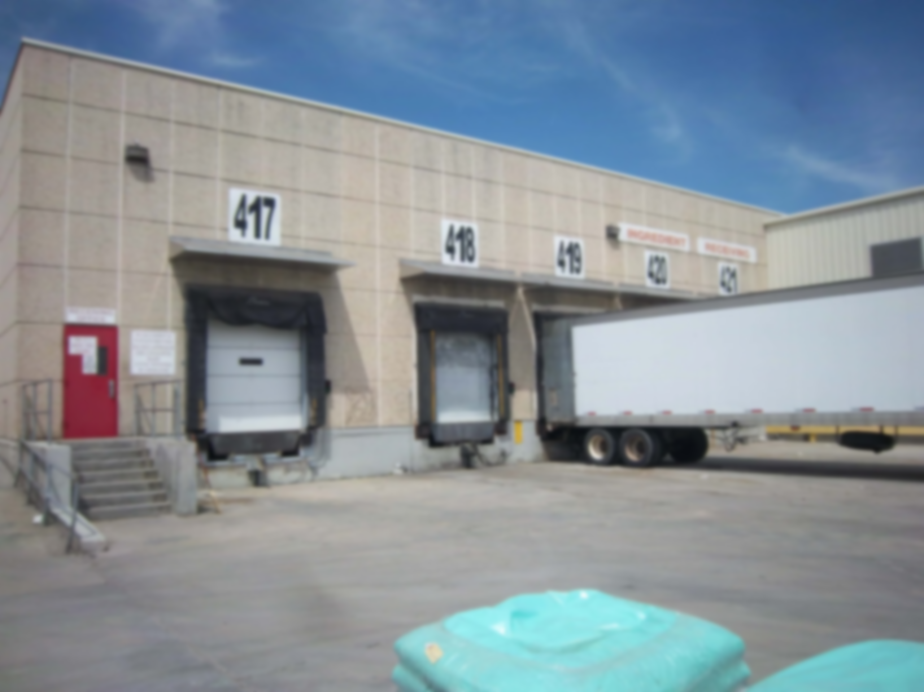
PROBLEM
Where’s that Trailer?
Trailers are not tracked
No movement documentation
Are we expecting you?
Drivers arrive too early
Deliveries and pick-ups
Where should I park?
No visibility to open parking spots / dock doors
Is this one ready?
Loaded inbound trailer move to dock door
Empty trailer moves
Loaded outbound trailer move to parking spot

Slide 3
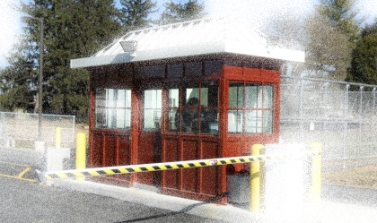

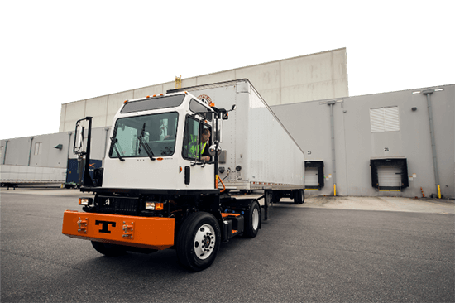
SOLUTION
COMPLETE WAREHOUSE VIEW
TARGET AUDIENCE
Provides a complete view of parking locations on the property and any trailers that occupy them
All warehouse team members gain some benefit
Gatekeepers, Spotters, WH Operators, Supervisors
TIME SAVINGS
EASY TO USE
Looking around for a trailer
Inquiring about open spots
Inquiring about trailer status
Simple design that gives customers the targeted information they need

Slide 4

FEATURES
DATA LOOKUP
Trailers on the property
Parking Spots and Dock Doors with status and occupancy
RECORD MAINTENANCE
Trailer Check-in and check-out
Trailer movements
Parking Spot and Dock Door status (active/inactive)
ROLE-BASED ACCESS
View / Add / Update / Delete per database table

Slide 5
Trailer management demo
http://localhost:8081/TrailerManagement/TrailerManagement.php

